Slide 1


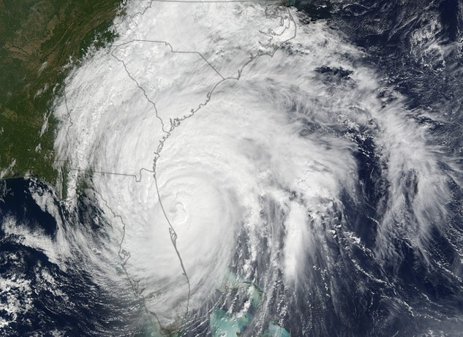
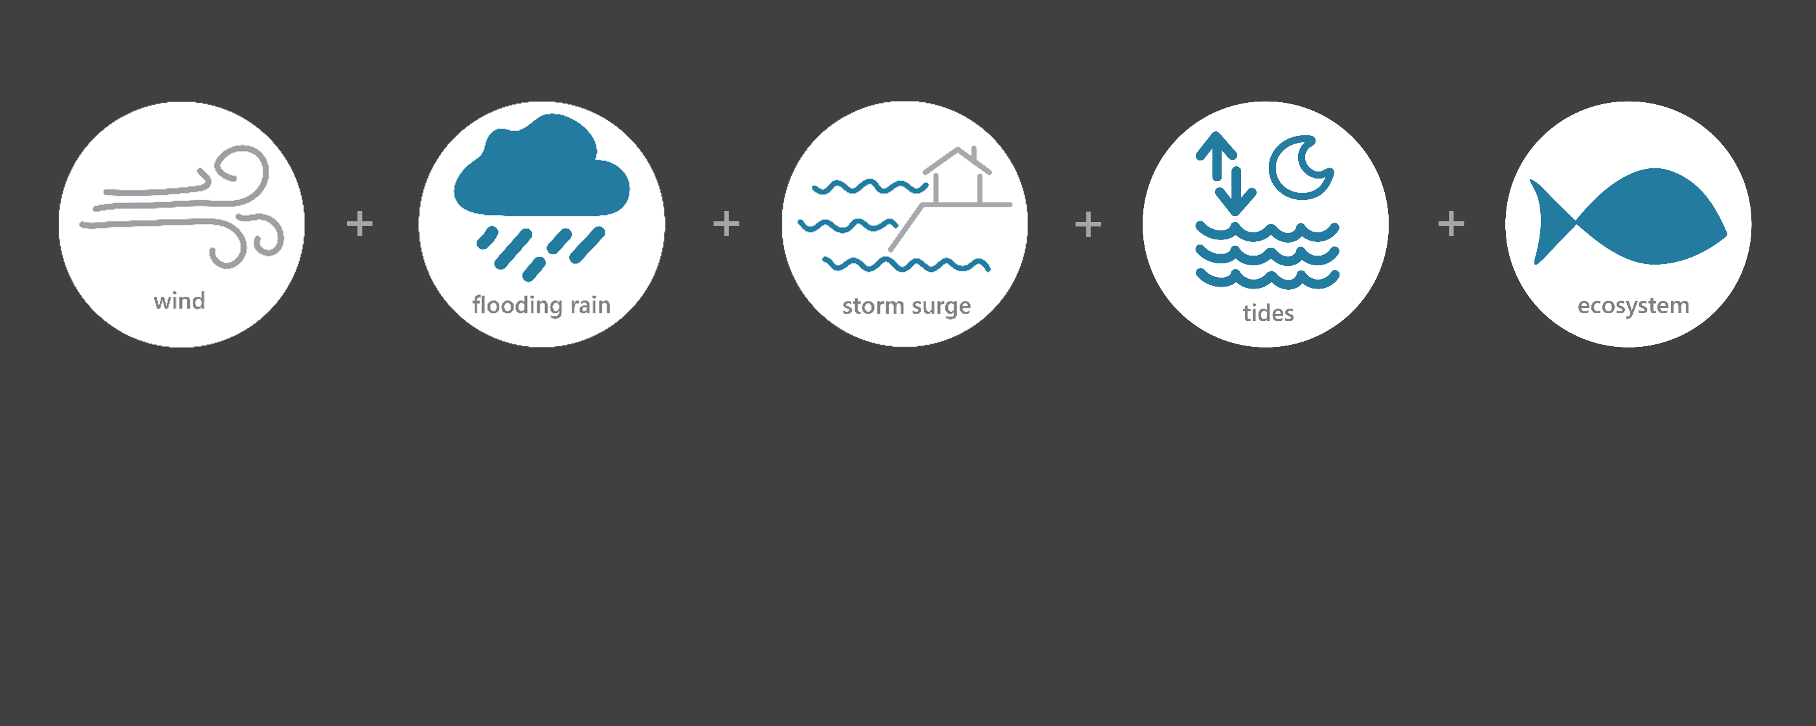

[ OCT 5 – OCT 10, 2016 ]
HURRICANE MATTHEW
1
Category
(very dangerous)
6.6
Inches of Rain*
47
Miles per hour
of Max Wind Gusts
4
Feet of Storm Surge**
Monitoring the Impact of Hurricane Matthew at “North Carolina NERR”
On Oct. 8th, Matthew moved parallel to the South Carolina coast as a category 1 hurricane until it made landfall near McClellanville, South Carolina. Matthew soon moved offshore, but the large eyewall extended well inland and brought hurricane-force wind gusts and heavy rains to coastal regions of the Carolinas. On Oct. 9th, Matthew traveled along the southeastern coast of North Carolina before continuing its path east-northeastward away from the state. The effects of Matthew were observed at the North Carolina (NOC) Basin Research Reserve through the System-Wide Monitoring Program (SWMP), which tracks short-term variability and long-term change in weather and water quality in the areas of Wilmington, South Port, and surrounding areas in New Hanover County in North Carolina.
Data shown are based on the NOC weather monitoring site
*Wilmington IAP (KILM) site
**NHC Report AL142016
Created on May 27, 2022

Slide 2

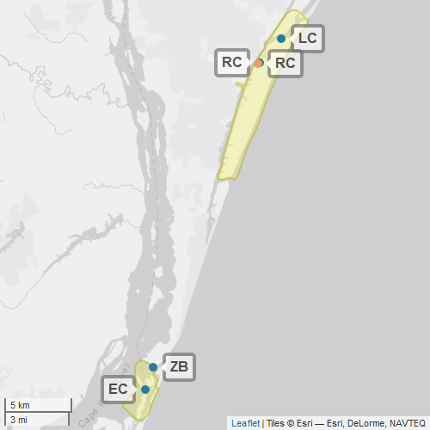
NOC
The North Carolina NERR (NOC) is one of 29 sites in the National Estuarine Research Reserve Systems (NERRS). Each site is a state-federal partnership that combines research, monitoring, and education to advance the understanding and management of estuarine environments.
North Carolina NERR
NERRS
Centralized Data
Management Office
North Carolina Storm Monitoring
North Carolina NERR operates a weather station located at Research Creek (RC) and maintains four continuous, long-term water quality stations at Research Creek (RC), Loosin Creek (LC), Zeke’s Basin (ZB), and East Cribbing (EC). North Carolina NERR is part of the SWMP. As Hurricane Matthew approached the state, North Carolina NERR monitored the weather and water quality, collecting data every 15 minutes for the following parameters: air temperature, relative humidity, atmospheric pressure, rainfall, wind speed and direction, water temperature, depth, salinity, dissolved oxygen, turbidity, and pH.
Weather Station
Water Quality Sample Location

Slide 3
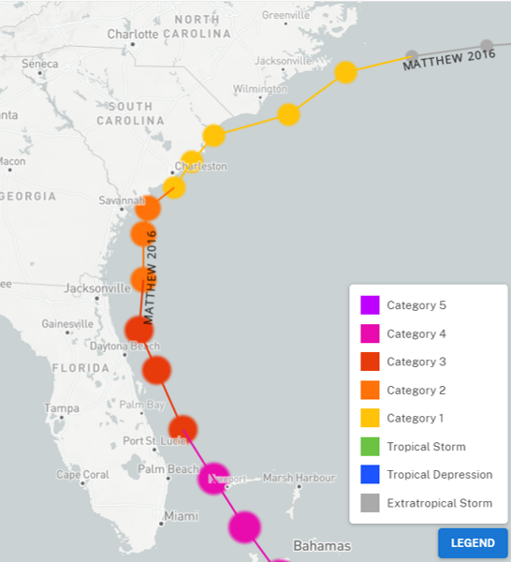
Matthew traveled along the Florida coast as a category 3 hurricane. Matthew weakened to a category 2 near the Georgia coast and then transitioned to a category 1 near South Carolina. On Oct. 9th, Matthew traveled along the southeastern coast of North Carolina before becoming an extratropical storm.
Freshwater flooding was widespread with low-lying areas impacted across several municipalities.
Flooding caused closures of roads and sections of interstates.
In New Hanover County, storm surge resulted in record flooding in downtown Wilmington.
Source: https://oceanservice.noaa.gov/news/historical-hurricanes/
NOC
Matthew was a Category 1 on the Saffir–Simpson scale when it made landfall along the southeastern coast of South Carolina. Matthew remained a Category 1 as passed the NOC reserve.
Matthew’s most costly impacts occurred in North Carolina where over $5 billion worth of damage was estimated. This was largely due to historic levels of river flooding in eastern North Carolina where 100,000 homes, businesses and other structures were damaged.
Aquatic life, like oysters, crabs, shrimp, fish, phytoplankton, etc. rely on specific levels of salinity and dissolved oxygen to thrive and survive. The weather impacts from Matthew caused significant drops in the levels of salinity and turbidity for varying periods of time, potentially stressing organisms.
Station | Date | Air Temperature Average (°F) | Barometric Pressure Average (atm) | Wind Speed Max (mph) | Wind Speed Average (mph)
Research Creek | 10/6/2016 | 70.93 | 30.038 | 19.5 | 12.0
Research Creek | 10/7/2016 | 76.28 | 29.945 | 26.4 | 13.9
Research Creek | 10/8/2016 | 77.31 | 29.526 | 47.4 | 24.5
Research Creek | 10/9/2016 | 68.53 | 29.738 | 40.0 | 15.1
Research Creek | 10/10/2016 | 61.52 | 30.174 | 25.5 | 11.1
The highest local wind measurements were recorded when Matthew approached North Carolina on Oct. 8. Wind speeds remained high early on Oct. 9.
Data reporting time periods for Hurricane Matthew: 10/6/2016 - 10/10/2016

Slide 4
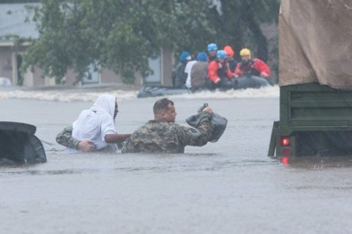
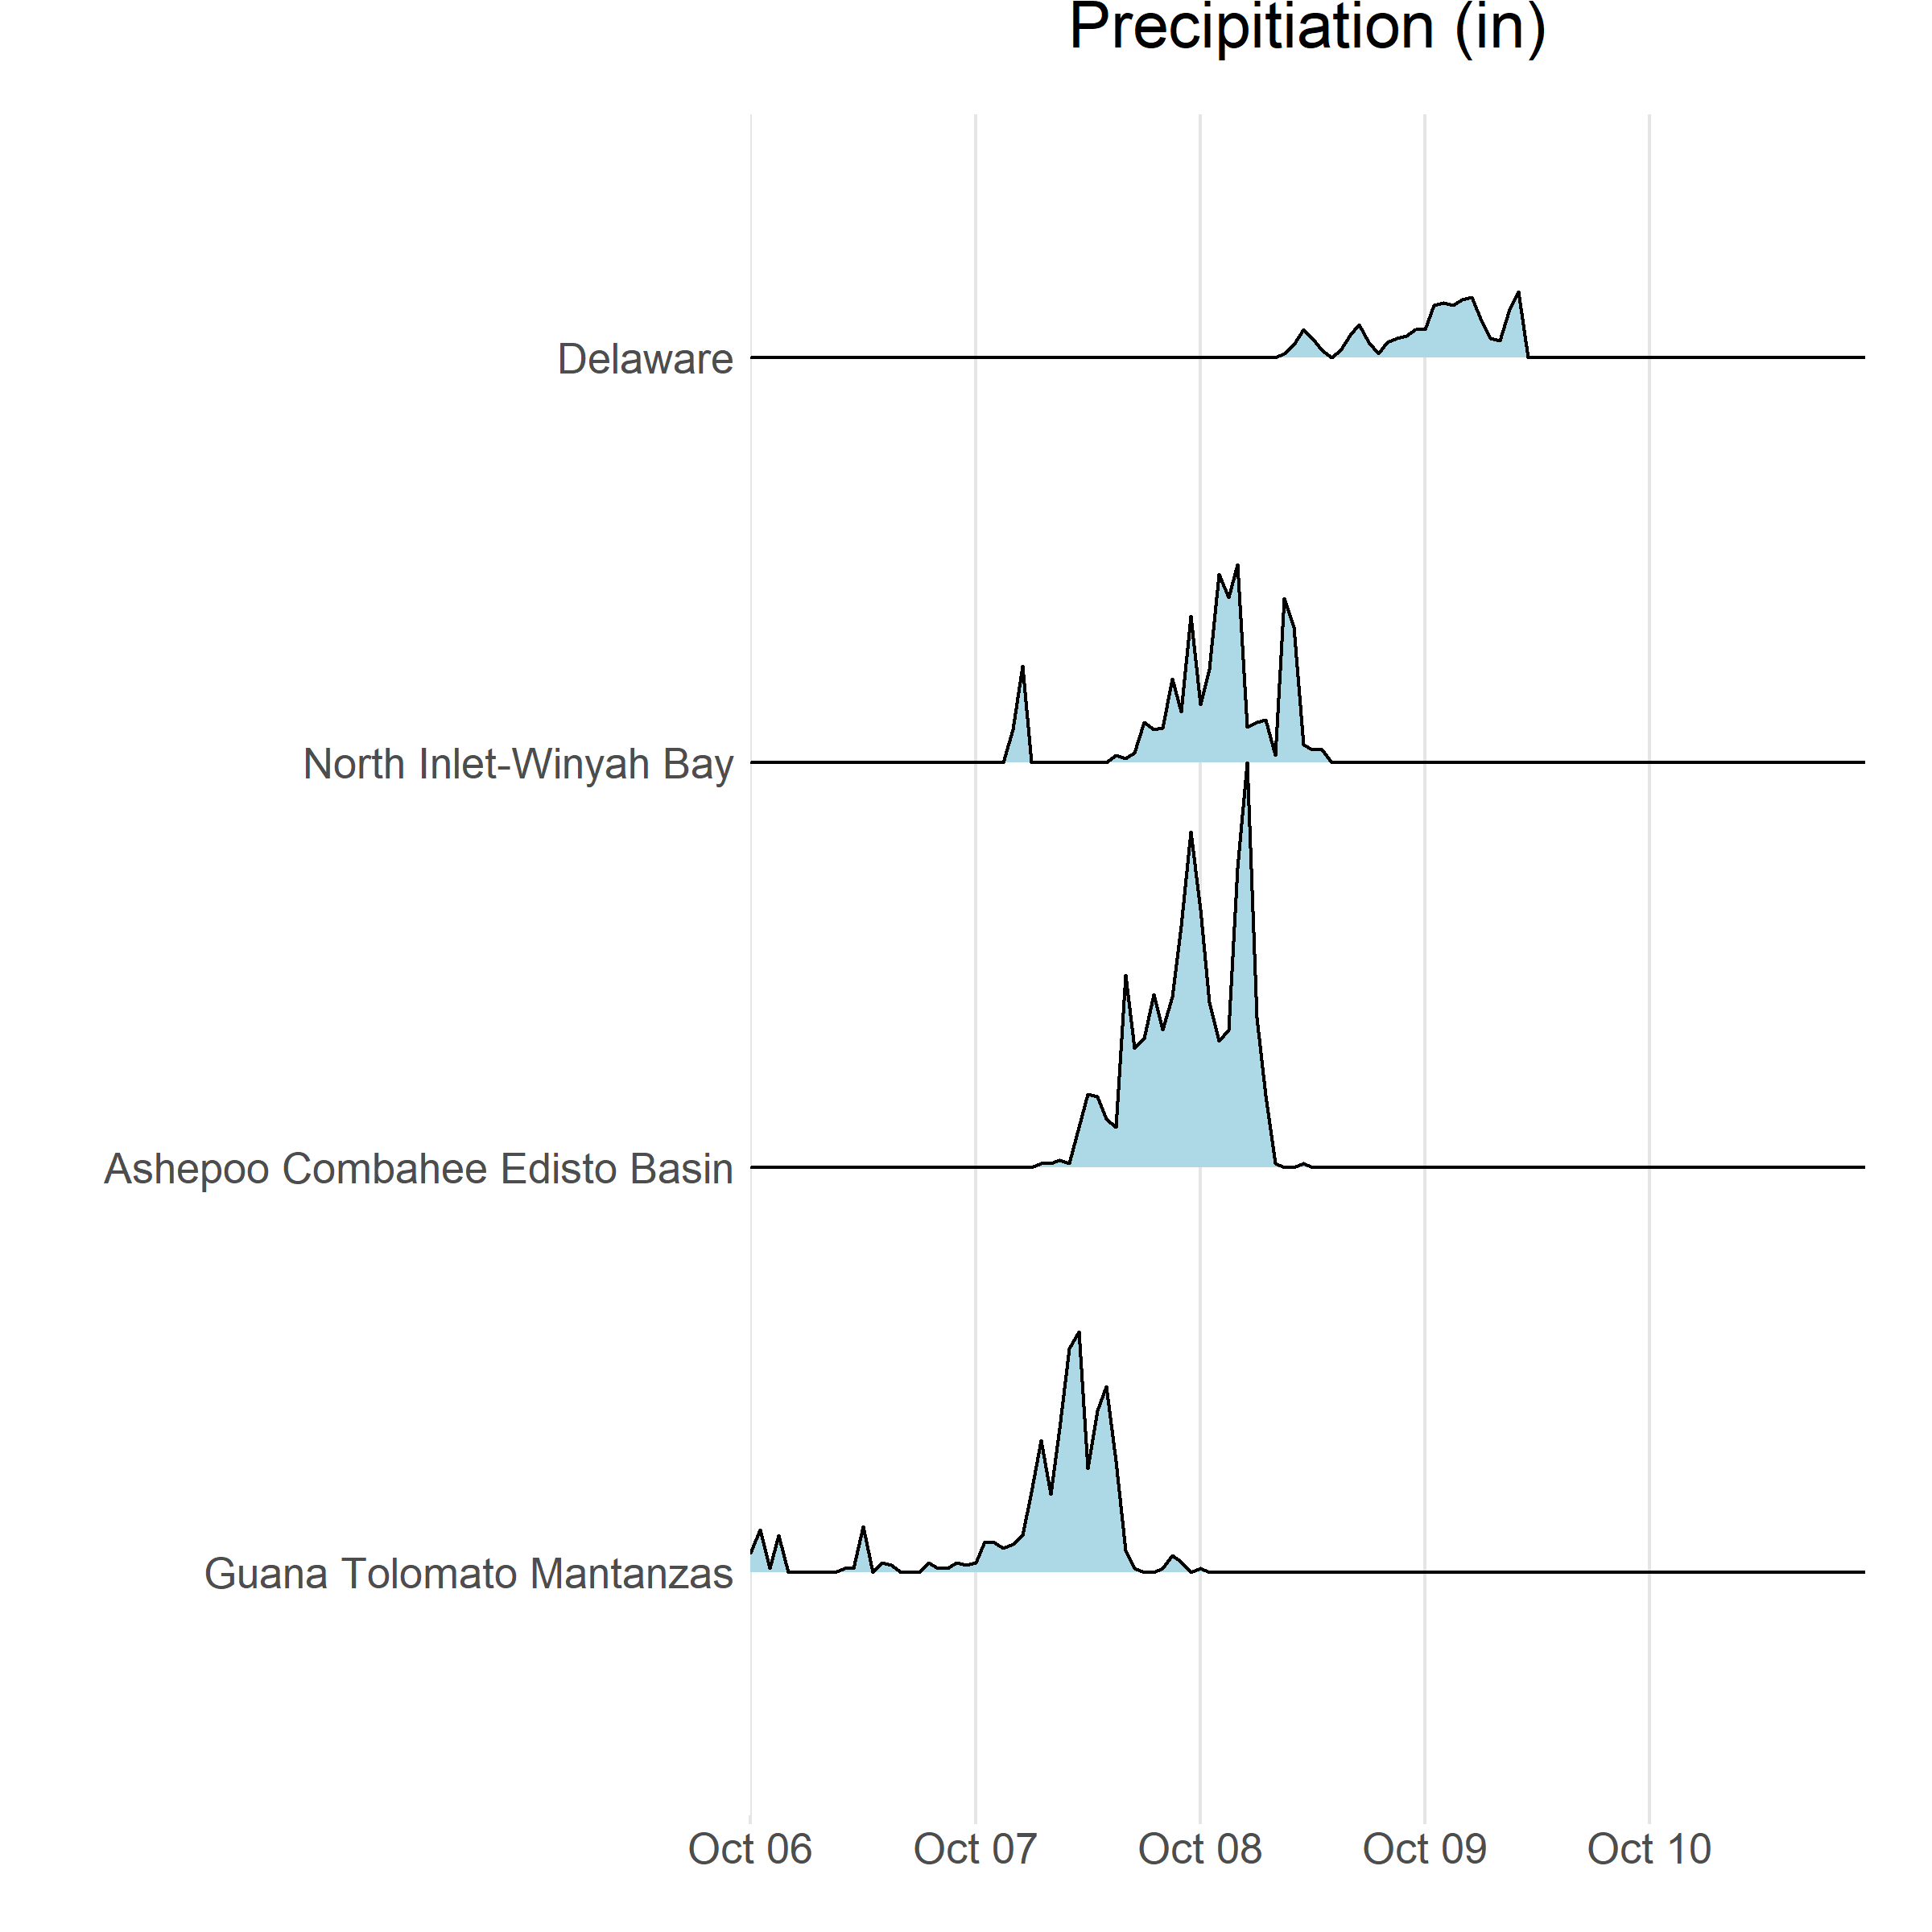


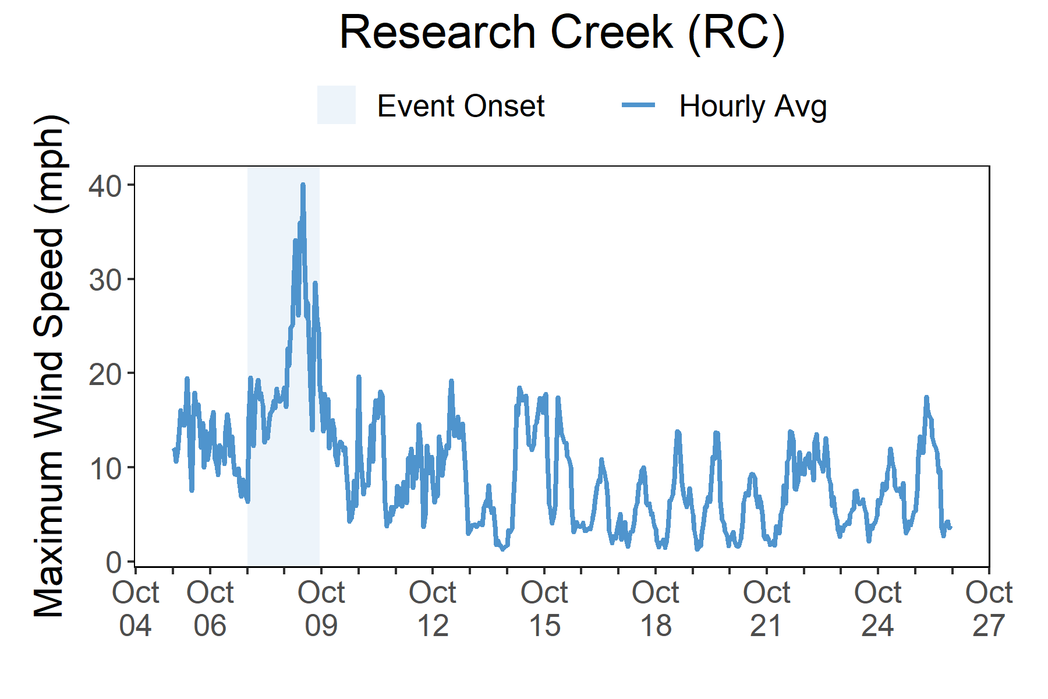

Rainfall
Matthew brought heavy rains, high winds, storm surge, and freshwater flooding to North Carolina.
Matthew caused heavy rainfall at reserves along the Atlantic coast with 6.6 inches total recorded at Wilmington, a gage near the North Carolina reserve.
In North Carolina, wind damage was primarily constrained to the immediate coastal areas. However, flood-producing rainfall was much more widespread. Torrential rains fell over eastern North Carolina with rainfall exceeding 10 inches in many places both along the coast and well inland.
In the southeastern portion of the state, maximum inundation levels were 2-4 ft above ground level. This resulted in record flood levels in downtown Wilmington. The highest coastal water levels were found farther up the coast on the sound side of the Outer Banks. Here maximum inundation levels were 4-6 ft above ground level. NOAA NCEI estimates that wind and water damage across the southeast totaled approximately $10 billion, making Matthew the 10th most destructive hurricane to affect the United States. The most costly impacts occurred in North Carolina. River flooding was the main cause of damage throughout the state, where historic flood levels damaged 100,000 homes, business, and structures.
Daily Rainfall measurements* at multiple reserves from Oct. 6 through Oct. 11.
Wind Speed
Max wind speed recorded at the reserve was 47 mph on Oct. 8
Maximum Wind Speed readings at the weather station from Oct. 5 through Oct. 26.
*No precipitation data were recorded at the NOC NERR rain gauge. Local rain data reported are based on the Wilmington IAP (KILM) site.

Slide 5
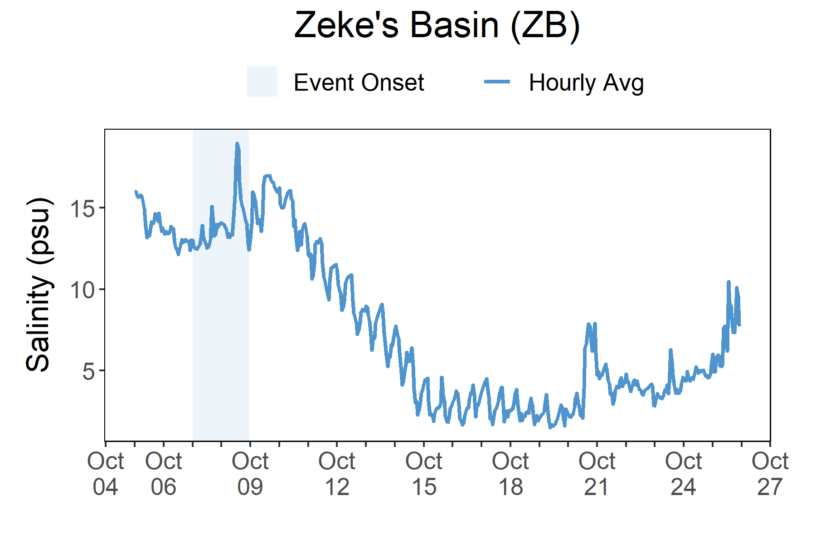
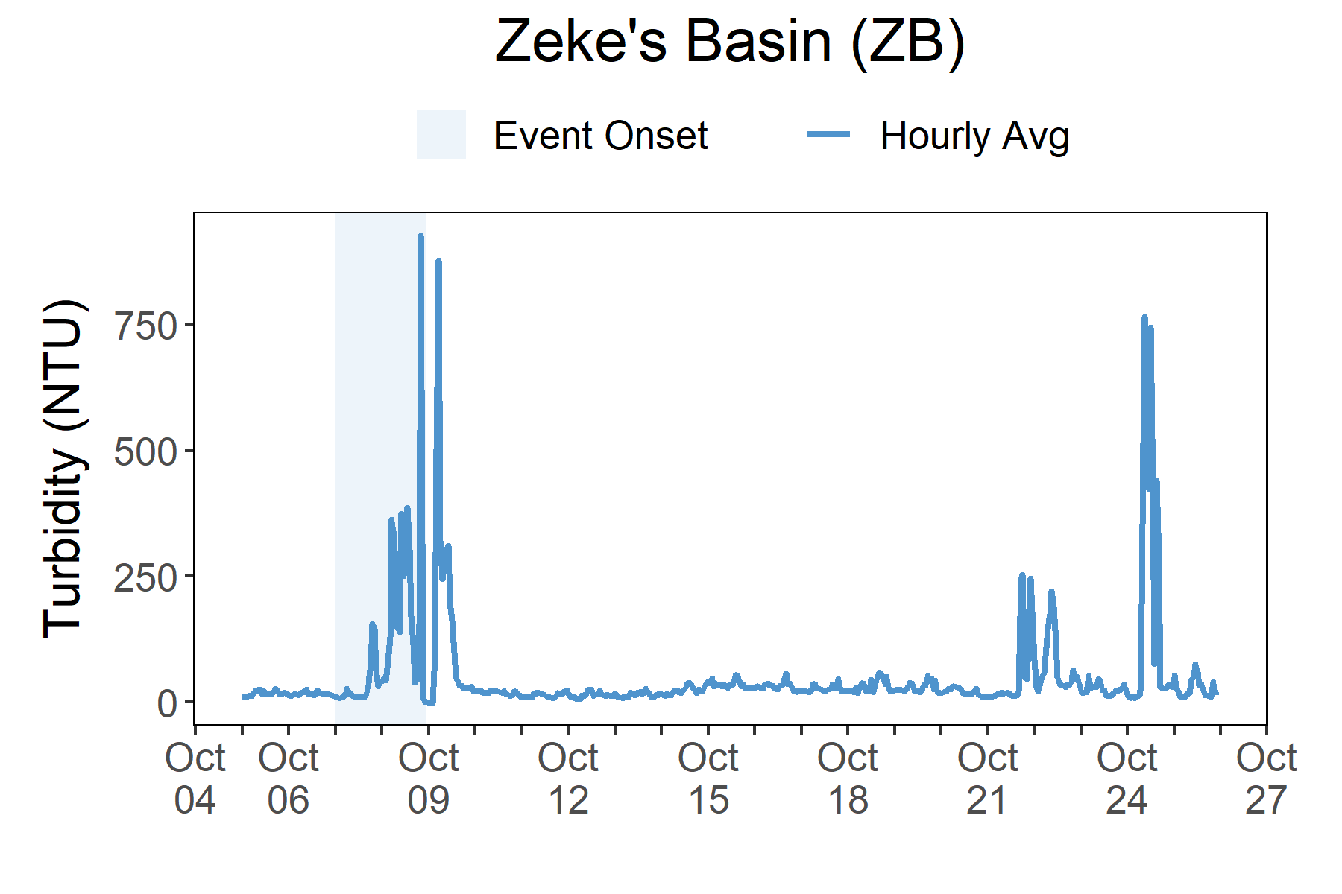
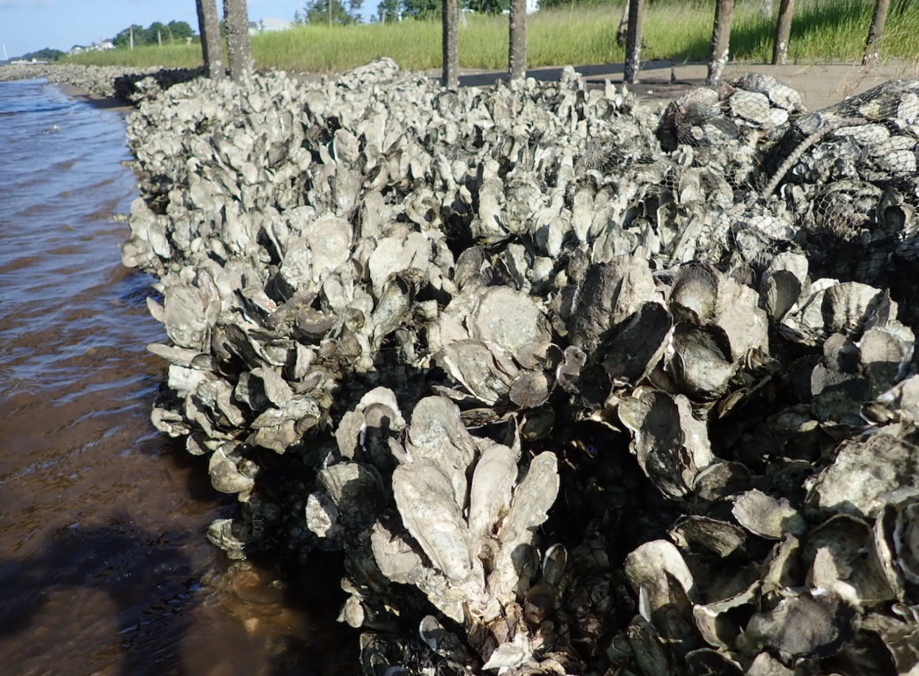
As Matthew approached North Carolina on Oct. 8, salinity levels peaked. Turbidity did not peak until the next day on Oct. 9.
Station | Date | Depth Maximum (ft) | Salinity Minimum (psu) | Salinity Maximum (psu) | Turbidity Minimum (NTU) | Turbidity Maximum (NTU)
Zeke's Basin | 10/6/2016 | 4.53 | 12.1 | 15.2 | 11.0 | 32.0
Zeke's Basin | 10/7/2016 | 4.56 | 12.3 | 16.2 | 7.0 | 133.0
Zeke's Basin | 10/8/2016 | 5.94 | 12.9 | 19.7 | 8.0 | 844.0
Zeke's Basin | 10/9/2016 | 4.40 | 12.3 | 17.2 | -1.0 | 947.0
Zeke's Basin | 10/10/2016 | 5.28 | 11.4 | 16.7 | 10.0 | 38.0
Data reporting time periods for Hurricane Matthew: 10/6/2016 - 10/10/2016
Salinity
Turbidity
Salinity increased with the onset of Matthew and then steadily declined as flooding occurred
A dramatic increase in turbidity occurred on both Oct. 8 and Oct. 9.
Salinity levels from Oct. 5 through Oct. 26.
Turbidity levels from Oct. 5 through Oct. 26.
Salinity and turbidity levels recorded at Zeke’s Basin show initial and post-storm impacts on water quality. Salinity levels increased as Matthew approached North Carolina. After the hurricane had passed salinity levels steadily dropped over the next week. Dramatic spikes in turbidity occurred during the onset of the storm and immediately after. On October 10, the turbidity measurements began to level off to pre-storm conditions. Dramatic increases in turbidity and shifts in salinity can cause stress to some aquatic organisms depending on the species and how long the levels deviate from what is normal. Water quality stresses can impact survival and future populations.
Every plant and animal species have habitat preferences and requirements. Understanding these habitats is critical to understanding populations.

Slide 6
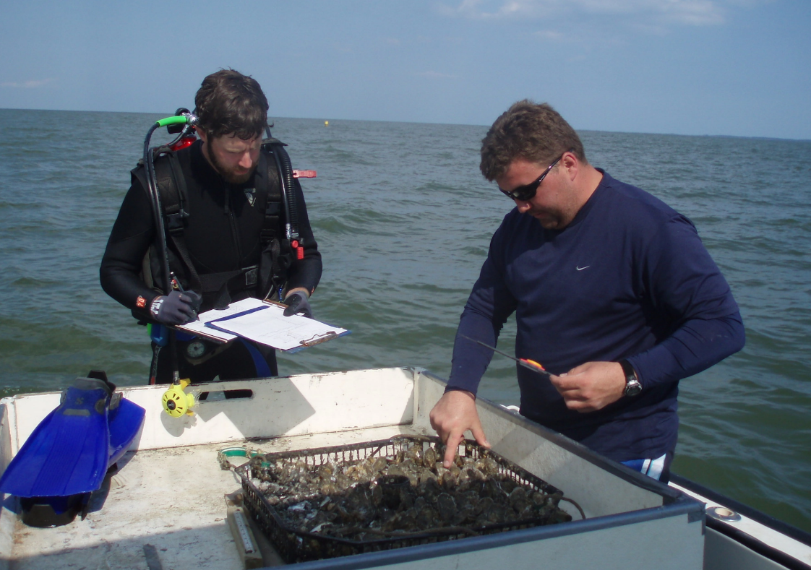



Brandon Puckett, Research Coordinator e: Brandon.Puckett@ncdenr.gov p: 252.838.0851
Visit www.nerrsdata.org to view and download weather and water quality data from North Carolina NERR.
Interested in learning more? Visit deq.nc.gov/coastalreserve For video, news updates, online storm data and prediction visualization tools, check out our Storm Story Map at www.storm storymap.url.
@NCReserve

